Slide 1

YEAR 9 CURRICULUM MAP
The progressive, inclusive curriculum ‘skills, knowledge and concepts: literacy, life skills and enrichment’
 | Autumn 1 Year 9
Autumn 1 – 7 weeks Literacy / Numeracy foci Reading Structured writing Essay writing Definition Numeracy Historical event dates List most/least important – trinity 3 in 1 explanation. Homework Exam question Stained glass window – create Revisiting, revising, remembering opportunities questions S&C Do now's – retrieval Starter sentences revision before EOT assessment Feedforward - peer-marking | Unit 1: Nature of God Christianity GCSE Assessment objectives: What is God like? To explore the idea of Monotheism within Christianity. Characteristics of God and The Trinity. Enrichment/life and work skills: Research skills Inquiry skills Exam content from Eduqas (WJEC) Module 1 - Beliefs Assessments: Explain different Christian attitudes towards the creation story found in Genesis 8 Mark Peer marked Key Objectives: K01,2,3,4 & 5 - 7,8,9 SMSC – Cultural and religious/spiritual viewpoints of the creation story for students to examine and consider. Impacts of religious beliefs on wider society. Wider Reading The attributes of God ‘’ by J.I Packer
 | Autumn 2 Year 9
Autumn 2 – 8 weeks Literacy / Numeracy foci Reading Structured writing Essay writing Definition Numeracy Historical event dates - timeline List most/least important Homework “It is clear that Jesus did not rise from the dead” Exam Question Revisiting, revising, remembering opportunities questions S&C Do now's – retrieval Starter sentences revision before EOT assessment Feedforward - peer-marking | Unit 2: Jesus Christ Christianity GCSE Assessment objectives: The understanding of the main key Christian beliefs about Jesus -Incarnation, his crucifixion and death, his resurrection, and his ascension. This then leads on to Salvation and afterlife. Enrichment/life and work skills: Research skills Inquiry skills CAIEG - Problem solving with inquiry-based knowledge of Jesus’ death – Law Analytics with looking at problems with at detail – uniformed public services Assessment – Full exam paper: 2ms of multiple answers to choose from, 5m, 8m, 15m Key Objectives: K01,2,3,4 & 5 - 7,8,9 SMSC – Cultural and religious/spiritual viewpoint on the nature of Jesus Christ as God incarnate. Secular views on the importance of Jesus’ teachings. Impact of these beliefs in a wider ‘Christian’ society. Wider Reading The case for Christ’ by Lee Strobel Extracurricular opportunities Local priest to come and speak to students about Jesus – followed by Q/A

Slide 2
YEAR 9 CURRICULUM MAP
The progressive, inclusive curriculum ‘skills, knowledge and concepts: literacy, life skills and enrichment’
 | Spring 1 Year 9
Spring 1 – 6 weeks Literacy / Numeracy foci Reading Structured writing Essay writing Definition Numeracy Numbering sacraments List most/least important Homework Research the 7 sacraments Revisiting, revising, remembering opportunities questions S&C Do now's – retrieval Exam questions focus Revision before EOT assessment Feedforward - peer-marking | Unit 3: Christian Practices GCSE Assessment objectives: Consider the importance of worship within Christianity and the different traditions within different denominations. Linking the 2 most important practical expressions of Christian faith being Eucharist and Baptism. Teamed with the idea of celebration within pilgrimages Festivals. Enrichment/life and work skills: Videos Research skills Public speaking Inquiry skills Assessments: “Pilgrimage is still important in Britain today”. 15 mark SPaG Key Objectives: K01,2,3,4 & 5 - 7,8,9 Wider Reading What is baptism by R.C. Sproul SMSC – Community and faith links though different practices in the Christian religion. Promoted British Values: Individual liberty in regards to religion and Mutual respect and tolerance in regards to key practices.
 | Spring 2 Year 9
Spring 2 – 6 weeks Literacy / Numeracy foci Reading Structured writing Essay writing Definition Numeracy Numbering sacraments List most/least important Analysing most recent census. Homework Choose one Christian practice and research in depth Revisiting, revising, remembering opportunities questions S&C Do now's – retrieval Exam questions focus Revision before EOT assessment Feedforward - peer-marking | Unit 4: Christian practices GCSE Assessment objectives: Consider the modern church in Britain and its importance within the local communities. Looking at the spread of Christians within church and Evangelist around the world. Martyrdom within faith and reconciliation around the world Enrichment/life and work skills: Videos Research skills Public speaking Inquiry skills Assessments: Full exam paper: 2m, 5m, 8m, 15m Christian practices section of paper Key Objectives: K01,2,3,4 & 5 - 7,8,9 Wider Reading Christianity in Britain by G. R. Evans SMSC – Community and faith links though learning about different practices in the Christian religion. Promoted British Values: Individual liberty in regards to religion and Mutual respect and tolerance in regards to key practices.

Slide 3
YEAR 9 CURRICULUM MAP
The progressive, inclusive curriculum ‘skills, knowledge and concepts: literacy, life skills and enrichment’
 | Summer 1 Year 9
Summer 1 – 5 weeks Literacy / Numeracy foci Reading Structured writing Essay writing Numeracy Historical event dates Listing aims of punishment most/least important Homework Research the aims of punishment in Christianity/Islam Revisiting, revising, remembering opportunities questions S&C Do now's – retrieval Exam questions focus Revision before EOT assessment Feedforward - peer-marking | Unit 5: Good & Evil 1 GCSE Assessment objectives: To understand the key knowledge of crime, punishment and capital punishment. To be able to link Christian and Islamic thought to the topic of Good and Evil. Enrichment/life and work skills: Research skills Public speaking CEIAG - Occupational views (Prison worker, chaplain, charity work) Assessments: Formative exams based questions throughout including exemplar exam question focusing on 5, 8 and 15 mark questions. Self and peer reviewed differentiated task on incarceration and capital punishment. Key Objectives: K01,2,3,4 & 5 - 7,8,9 Wider Reading The case against the death penalty ‘ by Hugo Adam Bedau SMSC –. Promoted British Values: Individual liberty in regards to religion and Mutual respect and tolerance in regards to peoples opinions about Good & Evil.
 | Summer 2 Year 9
Summer 2 – 7 weeks Literacy / Numeracy foci Reading Structured writing Essay writing Definition Numeracy Historical event dates Listing aims of punishment most/least important Homework Write a reflection on the concept of suffering in Christianity and Islam Revisiting, revising, remembering opportunities questions S&C Do now's – retrieval Exam questions focus Revision before EOT assessment Feedforward - peer-marking | Unit 6: Good & Evil 2 GCSE Assessment objectives: To understand the key knowledge of the problem of evil, examples of suffering, responses to suffering and evil. To be able to link Christian and Islamic thought to the topic of Good and Evil. Enrichment/life and work skills: Research skills Public speaking Inquiry skills Videos (movies), articles and websites CEIAG - Occupational views (Prison worker, chaplain, charity work) Assessments: Formative exams-based questions throughout including exemplar exam question focusing on 5, 8 and 15 mark questions. Self and peer reviewed differentiated task on incarceration and capital punishment. Key Objectives: K01,2,3,4 & 5 - 7,8,9 Wider Reading The problem of pain by C.S. Lewis SMSC –. Promoted British Values: Individual liberty in regards to religion and Mutual respect and tolerance in regards to peoples opinions about Good & Evil.

Slide 4
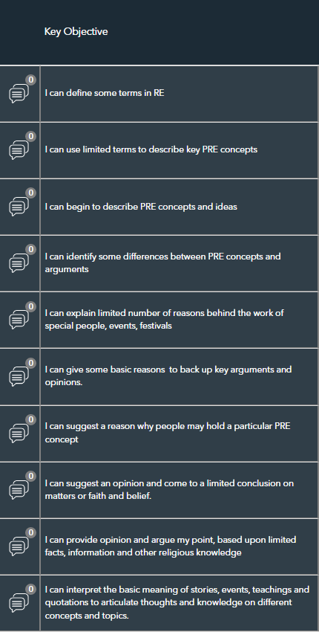
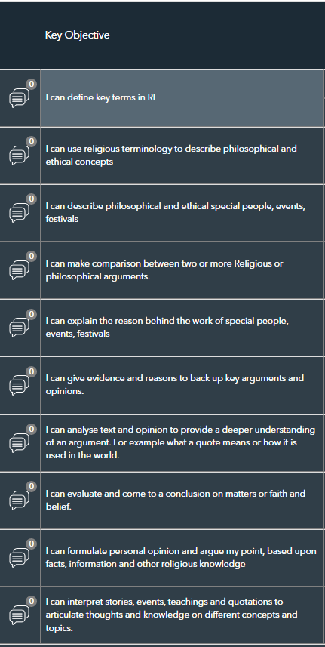
YEAR 9 CURRICULUM MAP
The progressive, inclusive curriculum ‘skills, knowledge and concepts: literacy, life skills and enrichment’
 | Year 9 KEY OBJECTVES – PATHWAY A
 | Year 9 KEY OBJECTIVES – PATHWAY B
 | )

Slide 5
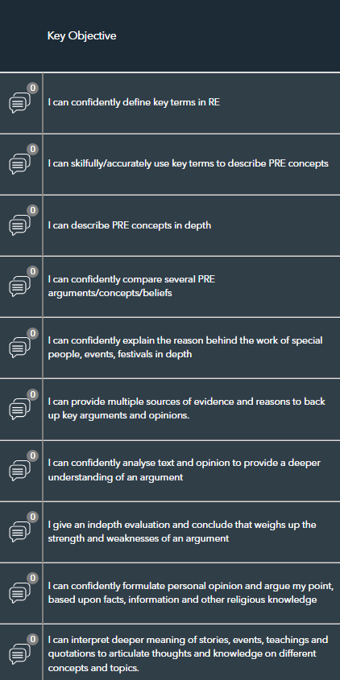
YEAR 9 CURRICULUM MAP
The progressive, inclusive curriculum ‘skills, knowledge and concepts: literacy, life skills and enrichment’
 | Year 9 KEY OBJECTVES – PATHWAY C

