Slide 1

YEAR 8 CURRICULUM MAP
The progressive, inclusive curriculum ‘skills, knowledge and concepts: literacy, life skills and enrichment’
 | Autumn 1 Year 8
Autumn 1 – 7 weeks Literacy / Numeracy foci Reading Structured writing Essay writing Definition Numeracy Historical events and dates Calculating dates of key events in years Homework Rosa Parks Story Board P&D poetry Revisiting, revising, remembering opportunities questions S&C Do now's – retrieval Starter sentences revision before EOT assessment Feedforward - peer-marking | Unit 1: Prejudice & Discrimination Assessment objectives: To be able to analyse the impact on P&D within History, while looking at the freedom fighters who helped. Enrichment/life and work skills: Videos Inquiry skills Group work Debates Presentations CEIAG – United Nations, Political Activists, Government, family members and working life SACRE’s focus of Christianity and 1 other – Islam as the demographic of the population of the school. Assessments: Comparing 2 religions and what their thought is with P&D 8 Mark with SPaG Help structured sheets – Sentence starter DPR Key Objectives: K01,2,3,4 & 5 - 7,8,9 SMSC – Importance of fundamental British values and society shown through impact of prejudice and discrimination both historically and today. Impacts of P&D on community and how spirituality and morality coincide through what makes a person “good”. Extra-curricular opportunities School linking opportunities – to share religious views on key issues . Wider Reading Martin Luther King Jr by: A life by Marshal Frady Malcom X: a Life of Reinvention by Manning Marable ‘’I am Malala The story of a girl who stood up for education and was shot by the Taliban by Malala Yousafzai
 | Autumn 2 Year 8
Autumn 2 (winter) – 8 weeks Literacy / Numeracy foci Reading Structured writing Essay writing Definition Numeracy Historical event dates - timeline List most/least important Homework Jesus Guide What did Prophet Muhammad do for Islam? Revisiting, revising, remembering opportunities questions Starters Keywords S & C’s Feedforward Peer marking | Unit 2: Prophets – Muhammad & Jesus Assessment objectives: To understand and explain the concepts of the Prophets within 2 religions - Islam & Christianity Enrichment/life and work skills: Research skills Inquiry skills Assessments: Jesus/Isa is more important than Muhammad? Discuss showing various religious points with more than one point of view 15 Mark with SPaG Peer marked Key Objectives: K01,2,3,4 & 5 - 7,8,9 SACRE’s focus of Christianity and 1 other – Islam as the demographic of the population of the school. SMSC – Importance of fundamental British values and society shown through impact of prejudice and discrimination both historically and today. Impacts of P&D on community and how spirituality and morality coincide through what makes a person “good”. Extracurricular opportunities Guest speaker to talk about the life of Muhammad – followed by Q/A Local priest to talk about the life of Jesus – followed by Q/A Wider Reading The Life of Muhammad by Ibn Ishaq Zealot: The life and Times of Jesus of Nazareth’’ by Reza Aslan

Slide 2
YEAR 8 CURRICULUM MAP
The progressive, inclusive curriculum ‘skills, knowledge and concepts: literacy, life skills and enrichment’
 | Spring 1 Year 8
Spring 1 – 6 weeks Literacy / Numeracy foci Reading Structured writing Essay writing Definition Numeracy Historical event dates List most/least important Homework Shomun’s Story – Revisiting, revising, remembering opportunities questions S&C Do now's – retrieval Starter sentences revision before EOT assessment Feedforward - peer-marking | Unit 3: Persecution Assessment objectives: To explore past persecutions within Religions and slavery past and present Human rights issues. Enrichment/life and work skills: Research skills Public speaking Inquiry skills CEIAG – Human rights issues and UN protocol, laws in the world and how different communities deal with these broken laws. Assessments: Moses – Slavery “Jewish Slavery in Egypt did not happen” (Discuss showing various points with more than one viewpoint.) (15) Key Objectives: K01,2,3,4 & 5 - 7,8,9 SMSC – Importance of fundamental British values and society shown through the impact of persecution both historically and today. What “we” can do today to stop or improve the bad treatment of others. Demonstrating tolerance to all. Wider Reading The slave ship: A Human History by Marcus Rediker
 | Spring 2 Year 8
Spring 2 – 6 weeks Literacy / Numeracy foci Reading Structured writing Essay writing Definition Numeracy Historical event dates List most/least important Homework Genocide around the world – Research Revisiting, revising, remembering opportunities questions S&C Do now's – retrieval Starter sentences revision before EOT assessment Feedforward - peer-marking | Unit 4: Persecution Assessment objectives: To understand what Genocide means around the world and those that have forgiven and used their religion as a way to move forward in society. Enrichment/life and work skills: Research skills Public speaking Inquiry skills CEIAG – Human rights issues and UN protocol, laws in the world and how different communities deal with these broken laws. Assessments: Human Rights – Persecution “Persecution has not changed in over 3000 years” (Discuss showing various points with more than one view point.) (15) Peer marked Key Objectives: K01,2,3,4 & 5 - 7,8,9 SMSC – Importance of fundamental British values and society shown through the impact of genocide and what religion has to offer of a solution of such historical monstrosities. Wider Reading ‘A people betrayed by Linda Melvern

Slide 3
YEAR 8 CURRICULUM MAP
The progressive, inclusive curriculum ‘skills, knowledge and concepts: literacy, life skills and enrichment’
 | Summer 1 Year 8
Summer 1 – 5 weeks Literacy / Numeracy foci Reading Structured writing Essay writing Numeracy Historical event dates List most/least important Homework Research on poverty, wealth and charity Charity information gathering task. Revisiting, revising, remembering opportunities questions S&C Do now's – retrieval Starter sentences revision before EOT assessment Feedforward - peer-marking | Unit 5: Special Places Assessment objectives: To understand, compare and analyse different places of worship, showing how respect is shown throughout holy buildings. Focus on the Church, Mosque and Gurdwara. Enrichment/life and work skills: Research skills Public speaking Inquiry skills Assessments: Summative assessment at end of unit focusing on specific knowledge learnt, evaluation based question and comparative exam style questions. Shorter formative assessment throughout. Key Objectives: K01,2,3,4 & 5 - 7,8,9 SMSC – British values and what the British landscape looks like with multicultural and religious influences. Empathy Wider Reading Inside Mosques by Mark W Houston The Sikh Gurdwara: Its meaning and purpose by Pashaura
 | Summer 2 Year 8
Summer 2 – 7 weeks Literacy / Numeracy foci Reading Structured writing Essay writing Definition Numeracy Historical event dates List most/least important Homework conduct a research on existing cities around the world to identify successful features/potential problems. Revisiting, revising, remembering opportunities questions S&C Do now's – retrieval Starter sentences revision before EOT assessment Feedforward - peer-marking | Unit 6: Build a City Assessment objectives: To review understanding of year 7 and 8 key topics through a creative project understanding the needs of those living in the UK – for example holy buildings, quality affordable housing, work and retail etc. Enrichment/life and work skills: Videos Research skills Mental health and mind-set Public speaking Inquiry skills CEIAG – The workings of society and organisation of people and money. Assessments: Summative presentation style assessment at end of project. Summative end of year test during Year 8 assessment week (review of learning from year 7 and 8) Key Objectives: K01,2,3,4 & 5 - 7,8,9 Wider Reading Ecocities: rebuilding cities in balance with nature by Richard Register

Slide 4
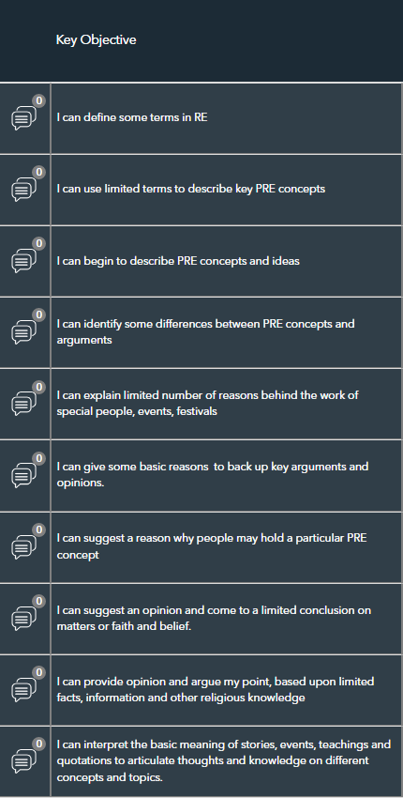
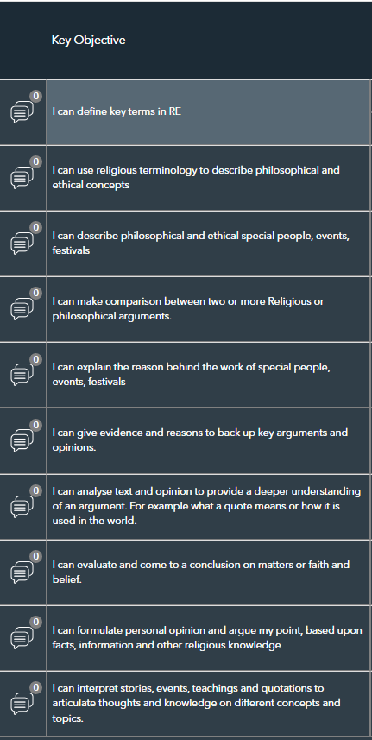
YEAR 8 CURRICULUM MAP
The progressive, inclusive curriculum ‘skills, knowledge and concepts: literacy, life skills and enrichment’
 | Year 8 KEY OBJECTVES – PATHWAY A
 | Year 8 KEY OBJECTIVES – PATHWAY B
 | )

Slide 5
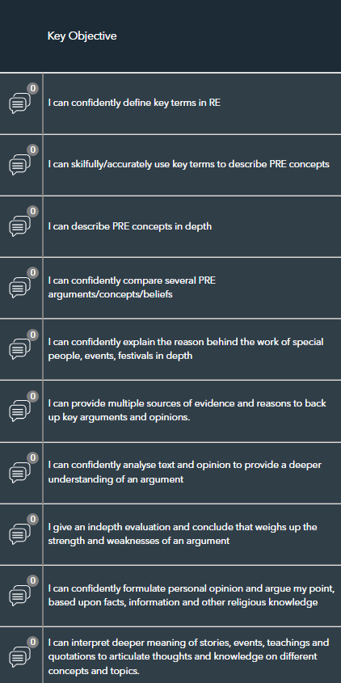
YEAR 8 CURRICULUM MAP
The progressive, inclusive curriculum ‘skills, knowledge and concepts: literacy, life skills and enrichment’
 | Year 8 KEY OBJECTVES – PATHWAY C

