Slide 1


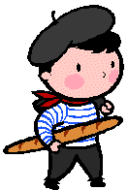

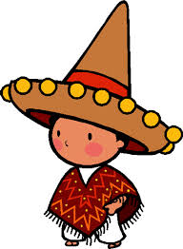




Year 6 Transition Summer Homework
Your task:
Research a French or Spanish speaking country and create a poster to summarise your findings. Some ideas:
create a recipe card in the target language (Spanish or French)
research a French or Spanish celebrity
Draw the French or Spanish football teams
Your poster should consist on one page of A4.
Don’t forget to include pictures!

